Slide 1
Unity and Vuforia
Dr Panchali Datta Choudhury
Assistant Professor
UEMK

Slide 2
Fundamentals of image target
How to capture an image which can be used as image target
Next we will create a vuforia license key and upload your image inside vuforia database and find out its star rating
Activate the webcam and project a humanoid 3D model on top of the image target
Finally build this complete project and test its output on your android smartphone

Slide 3
Importing Vuforia Package inside Unity
Create a unity project
Create a Vuforia Development account
https://developer.vuforia.com/
Import Vuforia SDK inside Unity project

Slide 4
IF THERE IS PROBLEM IN INSTALLING VUFORIA PACKAGE FROM THE PREVIOUS WAY
Download Vuforia core sample from asset store and install vuforia package from core samples

Slide 5
Web camera output
Delete the normal main camera and add AR camera
AR camera will activate the webcam of laptop when you will check output in play mode
Activate back camera of when testing output on smart phone
After adding AR camera next if I play button then you can see the output from external webcam

Slide 6
Creating project license key
Open Vuforia
Inside Vuforia engine portal click on the Develop tab
Then click on License Manager tab
For creating a new license key click on Get Development Key
Give license key name
Click terms and conditions checkbox

Slide 7
Copy the license key ( a long string of text )
Paste it inside Unity
Open Unity project
AR camera → Open Vuforia engine configuration
Paste license key
After pasting the license key get automatically linked to the AR camera the minute we paste

Slide 8
Capturing Image
Image target is a normal image which we place in front of the webcam or Smartphone camera
Once the image is recognized we will project a 3D model on top of it
Image target are also referred to as Marker’s in AR
We will capture an image and then crop out its unnecessary parts

Slide 9
Capturing image
Camera Scanning App instead of inbuilt camera app
Microsoft Office Lens (free)

Slide 10
Creating Vuforia database
Goto Vuforia account
Develop tab→Target Manager Tab
Add Database
Give a name to the database and select type as Device
Device Target means Image target will be saved inside Smartphone’s device
Cloud option means that the image target will be stored inside vuforia cloud and for accessing we need Internet connection

Slide 11
Vumark is an advanced image target technology developed by vuforia
These are similar to QR codes or barcodes
We can develop multiple image targets which look similar but all the images have different feature points that distinguish them from each other

Slide 12
Create a database
Add Target
Single image
Browse button
Open
Jpeg
2mb
Width I meters (scale accordingly)

Slide 13
Yellow points are representation of how well the image will be recognized by the Smartphone camera or webcam
Image Processing recognizing unique points

Slide 14
Download the database
select unity option
Import the database package inside unity project

Slide 15
Projecting a 3D model on the target image
Plus sign dropdown to add image target
In the vuforia engine change from image to from database
Select the database from the database dropdown
Since this database contains only one image select the image from the dropdown

Slide 16
In the advanced option you can see the width of the image and height
To test the augmented reality output, we place a cube on top of the target image

Slide 17
Testing o/p on Android smartphone
Build and Run AR app
Cross check whether JDK and SDK is installed in Unity
Go to edit → preferences
Go to External Tools scroll down to android option

Slide 18
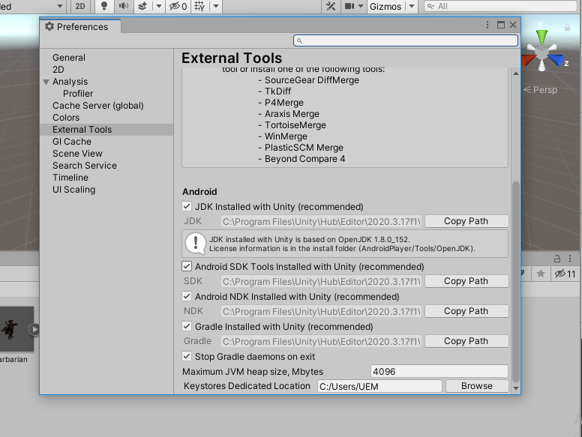

Slide 19
If you have not downloaded during installation
For installing check version, go to Unity Hub
Open installs
Three dots on that particular version
Add modules
Grey checkbox means installed
Blue not installed

Slide 20
Restart Unity
Building app
File build settings
Android platform
Switch platform
Add sample scene

Slide 21
Player settings
Change company name
Give your name
Product name →app name
Change default icon to set a logo for your app
Drag image inside Unity
Data file → logo → logoimg
Default to 2D sprite

Slide 22
Drag logo to set ICON
Inside Resolution
Landscape left
Other settings
Remove vulcan graphics (avoid black screen)

Slide 23
Package name
Select minimum API level lolypop
Maximum API level
Renamed as company name and product name
com.companyname.productname
Free to change

Slide 24
Build settings
Build
ARLONE.apk
Save
After the apk file is created we will transfer it to android Smartphone
Connect Android Smartphone via USB

Slide 25
Transfer the app to your smartphone
Install it
Run the app in your Smartphone to test it

